Slide 1
Bus Stop Buddy
SWOLE TEAM SIX
PROJECT BY:
BRIAN FREEMAN
DAN WISEMAN
DENNIS KELLOGG
LAMIS ALQAFSHAT
LUKE JERIES
TAYLOR SHEPARD

Slide 2
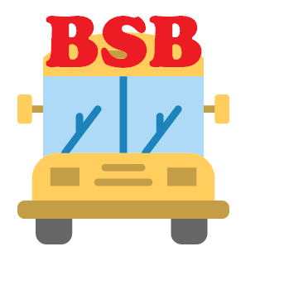
What is Bus Stop Buddy?
Bus tracking application via GPS

Slide 3

Features of Bus Stop Buddy
Alert System
Notifies user of arrival times for pickup and drop-off
Creation and editing accounts
Allow the driver to notify parents/school of problems
Bus selection for tracking
Viewing information

Slide 4

Why Bus Stop Buddy?
This application appeals to busy parents
Allows for precision timing
Safety
Updates on problems

Slide 5

Requirements Personas
Application
GPS Tracking
Estimated time of arrival/pickup
Contact Information
Maps
Parents
Drivers
Students

Slide 6
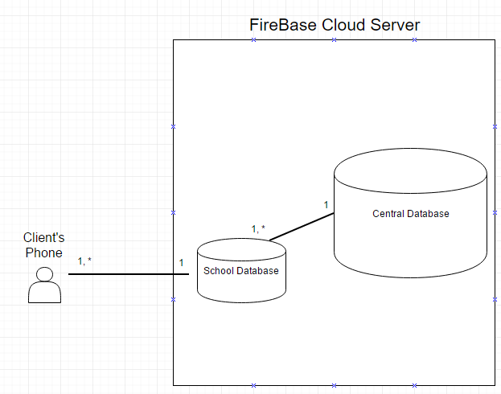
Architecture
Client server

Slide 7
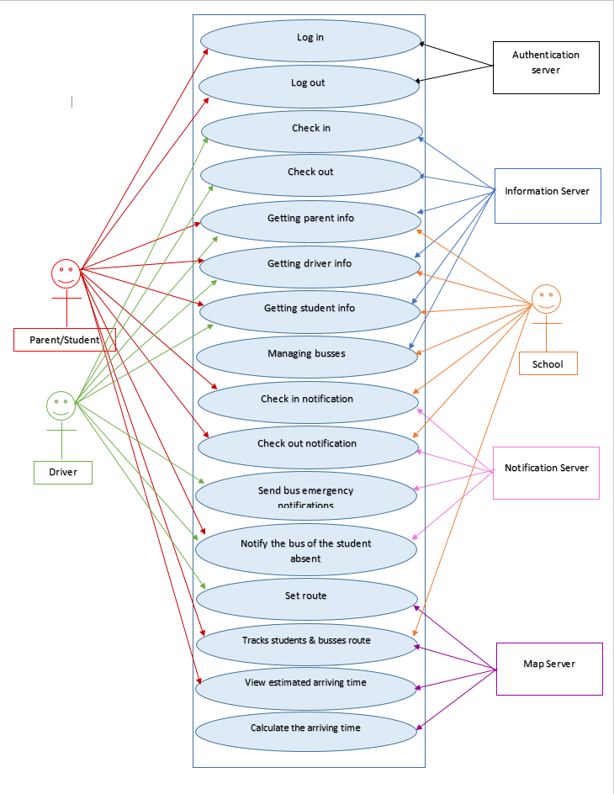
Use Case Diagram
Actors
Parents
Students
Drivers
Secondary Actors
School
Databases

Slide 8
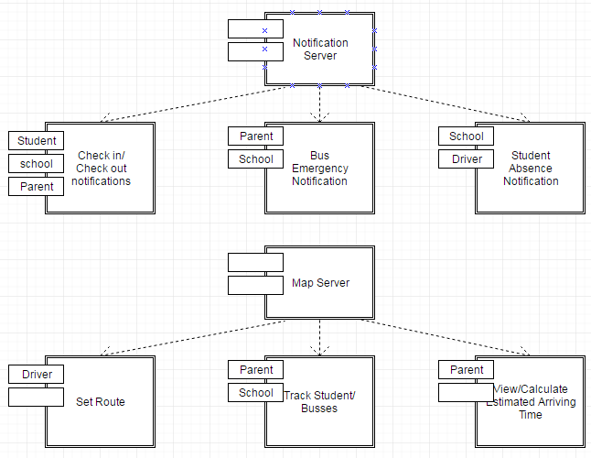
Subsystem Decomposition
Examples

Slide 9

Persistent Data Management
FireCloud Database
User Information
Routes
Personal Device
Username/Password
Personal Settings

Slide 10
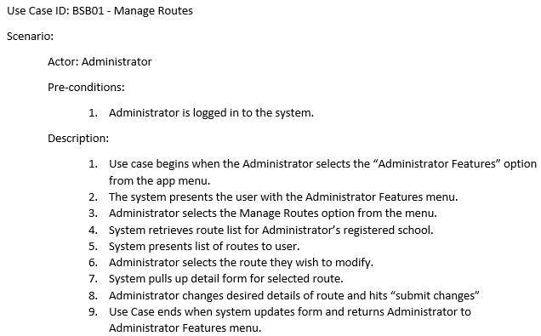
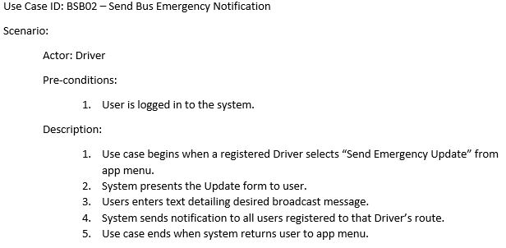
Text Use Cases
EXAMPLE 1
EXAMPLE 2

Slide 11
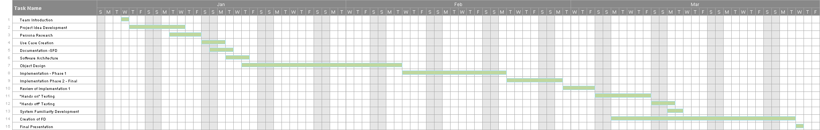
Gantt Chart

Slide 12
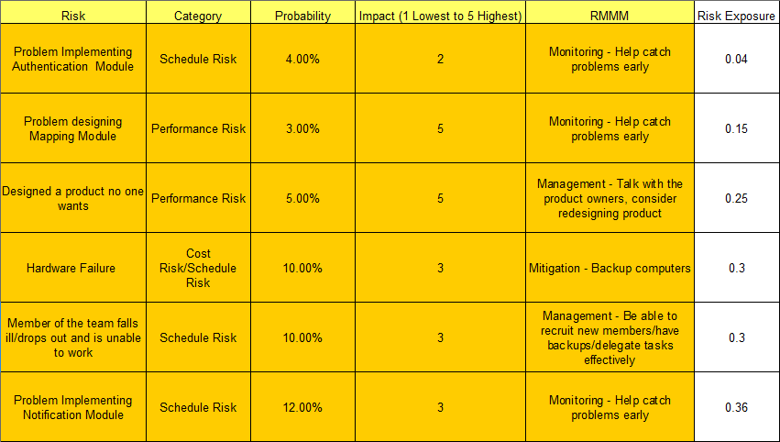
Risk Management

Slide 13
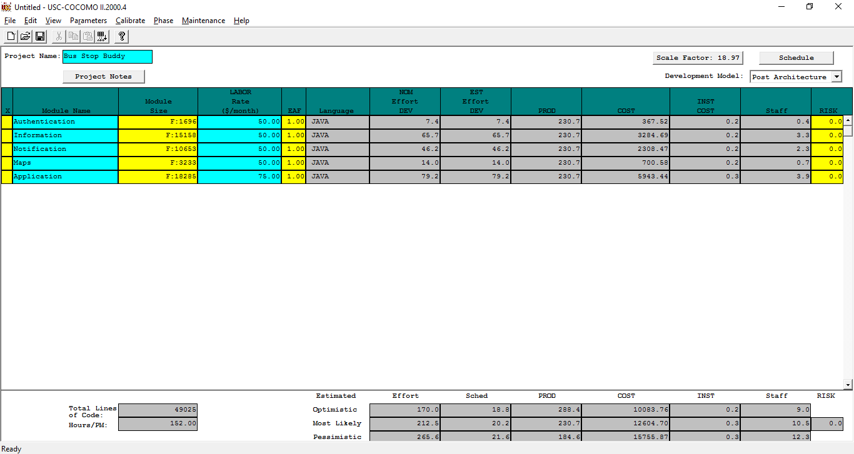
COCOMO

Slide 14
Demo

Slide 15
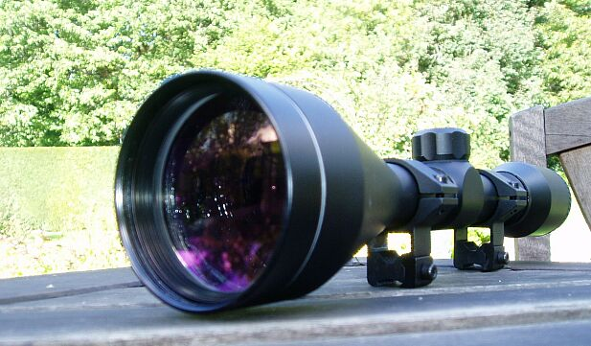
Scope too Large?
Too many plans
Not enough expertise
Schedule changes
Functional Vs. Nonfunctional

Slide 16


Too Many Features, Not Enough Time!
RFID
CLOUD DATABASE
Simplifies student check in
Nonfunctional Requirement
Single storage location for information.

Slide 17

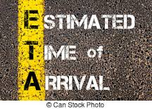
Too Many Features, Not Enough Time!(cont)
NEW ROUTE
ETA
Allows updating of routes incase routes get longer or shorter
New route creation
Traffic
Amount of kids in queue
nonfunctional

Slide 18
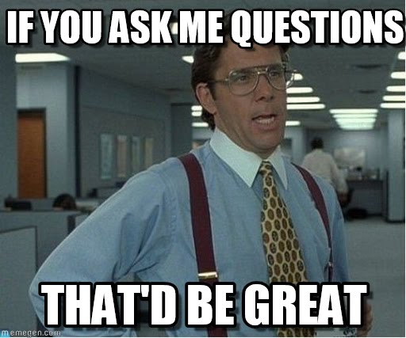
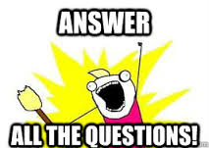
Questions?

Slide 19

Thanks for Listening!
Be sure to leave us feedback so we can fine-tune our project!

